Slide 1
Analysing Amazon Sales data

Slide 2
The Industry
# Amazon is a part of the "e-commerce"
Industry.
# The industry has grown about 10% or more
each year for the past 15 years.
# In the recent years, online shopping has
become so easy with so many devices
such as Mobile phones, Tablets, Laptops.
Amazon is seen as being one of the world's
largest online retailer.

Slide 3
Problem Statement:
Sales management has gained importance to meet increasing competition and the need for improved methods of distribution to reduce cost and to increase profits. Sales management today is the most important function in a commercial and business enterprise. Do ETL: Extract-Transform-Load some Amazon dataset and find for me Sales-trend -> month-wise, year-wise, yearly month-wise Find key metrics and factors and show the meaningful relationships between attributes. Do your own research and come up with your findings

Slide 4
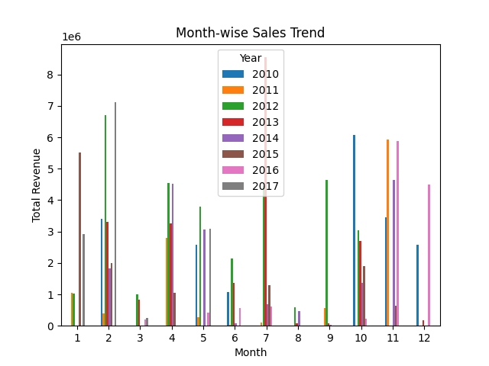
Dashboard
Analysing Amazon Sales data

Slide 5
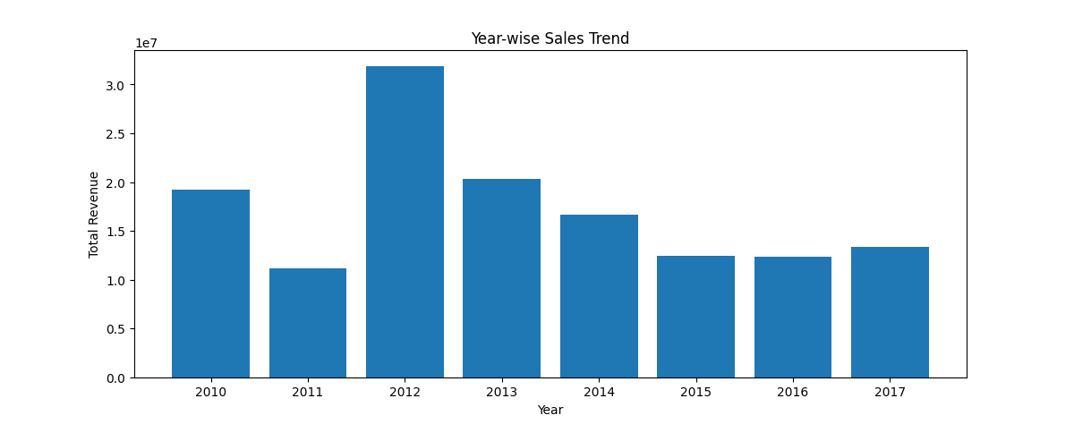
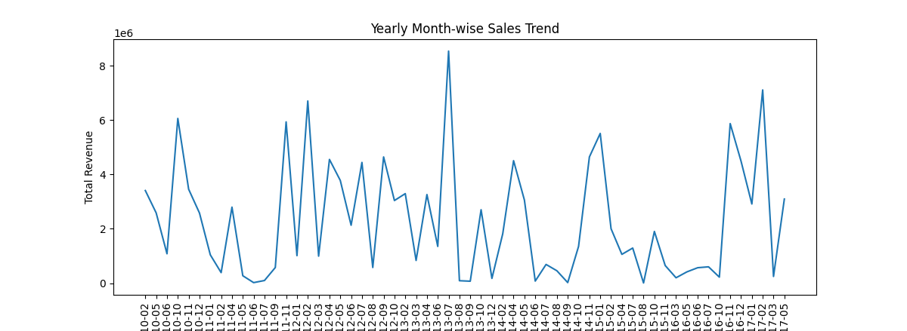

Slide 6
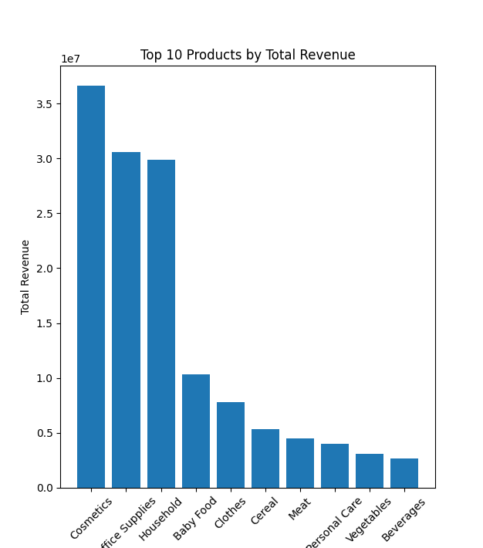
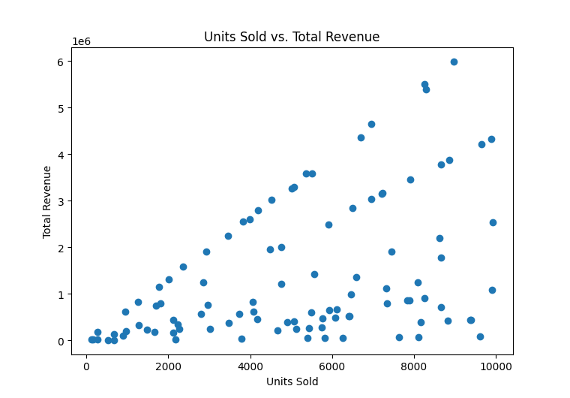

Slide 7
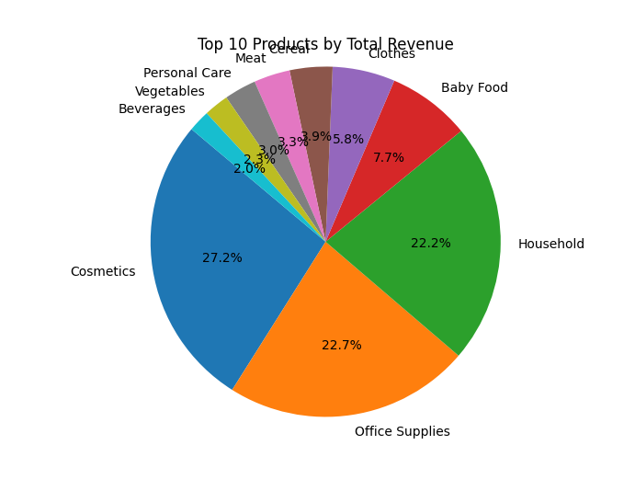

Slide 8
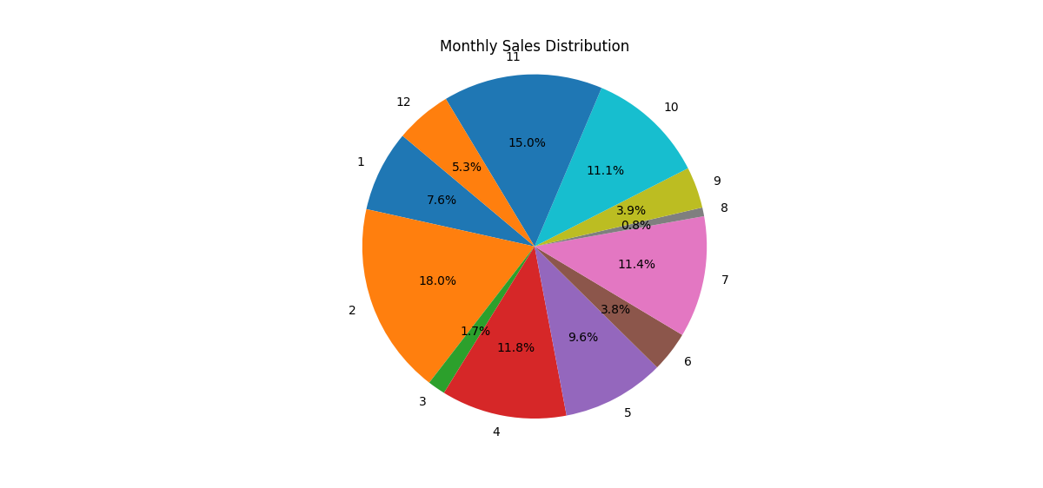

Slide 9
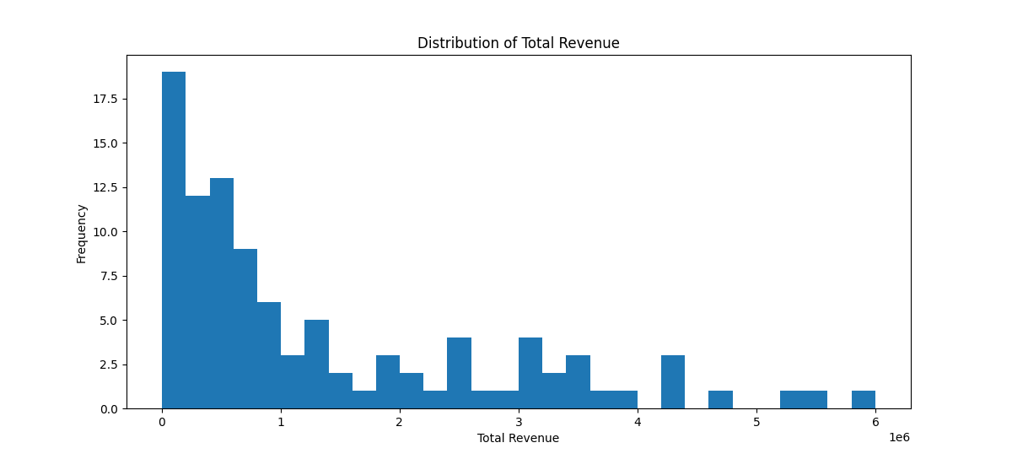
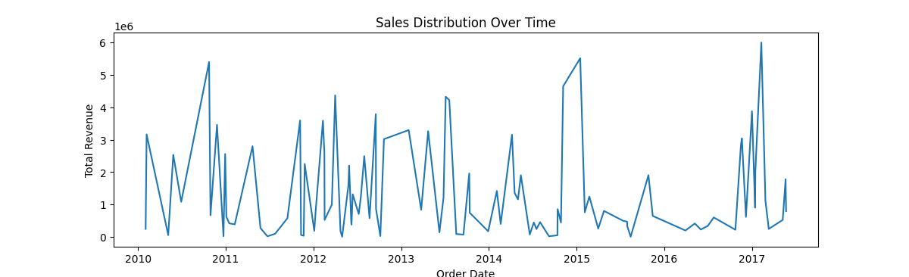

Slide 10
Thank you

